Slide 1
PubHub
Trivia, Chat, Food

Slide 2
The App
The App for patrons has four main parts:
Trivia: View, Play, and grade trivia.
Chat: Interact with both the pub and other patrons while playing.
Ordering: Order food and drinks.
Billing: Pay your bill with card, or with cash using QR codes.

Slide 3
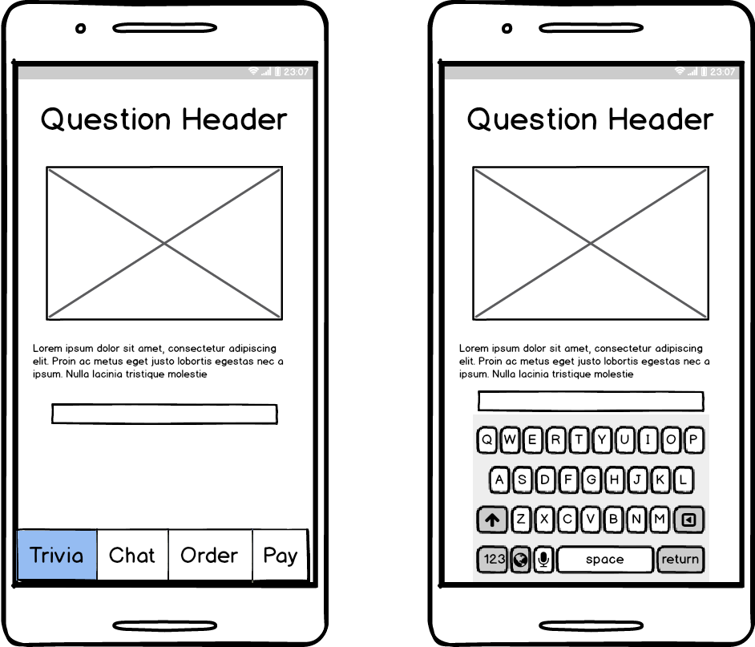
Trivia

Slide 4
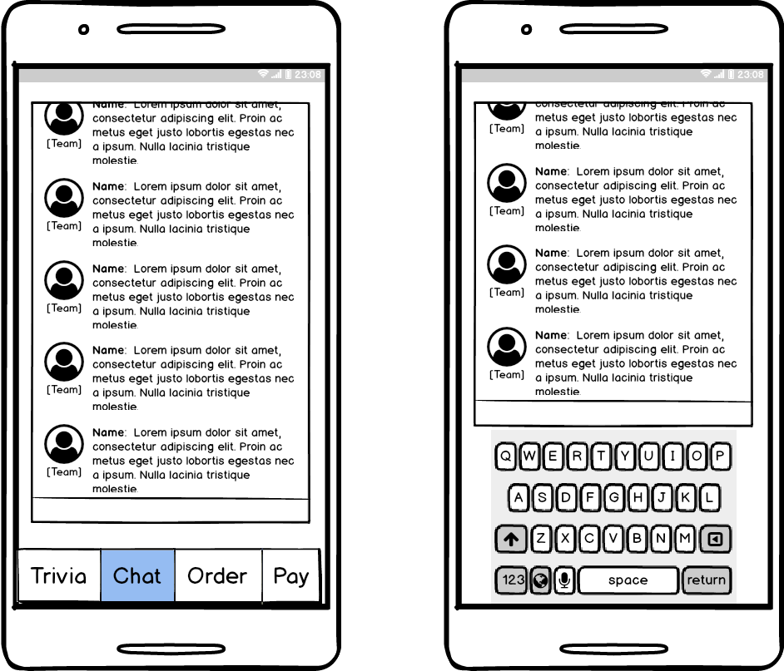
Chat

Slide 5
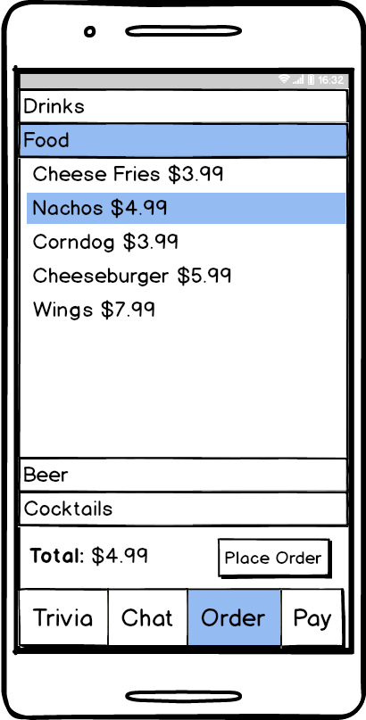
Ordering

Slide 6
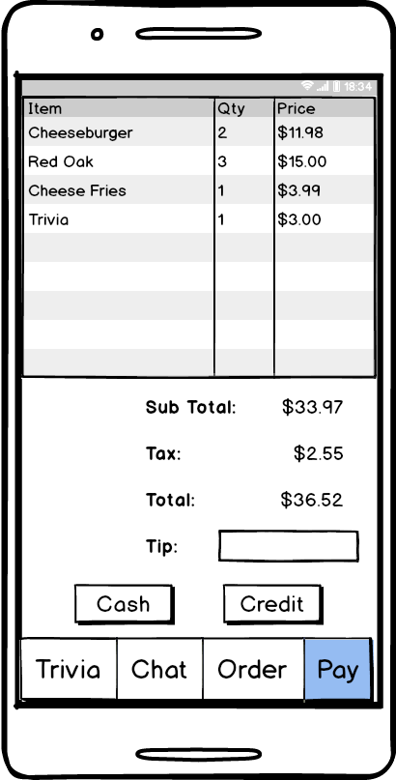
Billing

Slide 7
The Web Interface
The web interface for the pub has three main parts:
Trivia: Create and Present trivia Questions.
Chat: Interact with pub patrons.
Orders: View and complete orders.

Slide 8
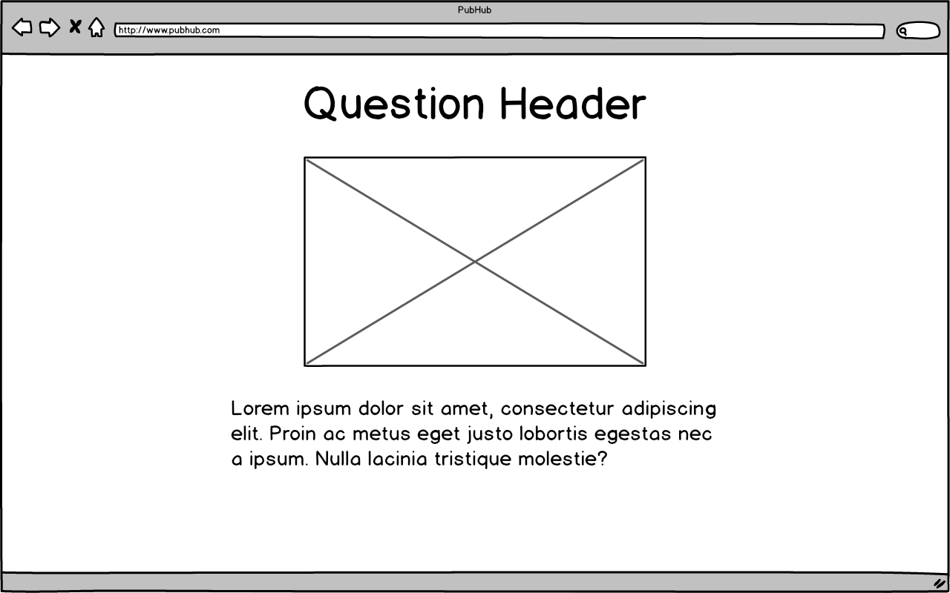
Trivia

Slide 9
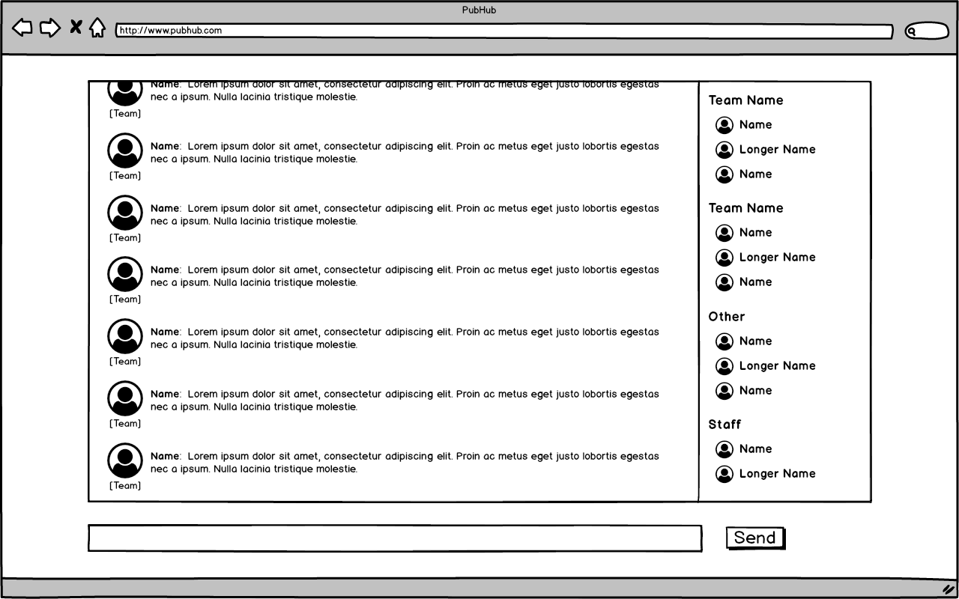
Chat

Slide 10
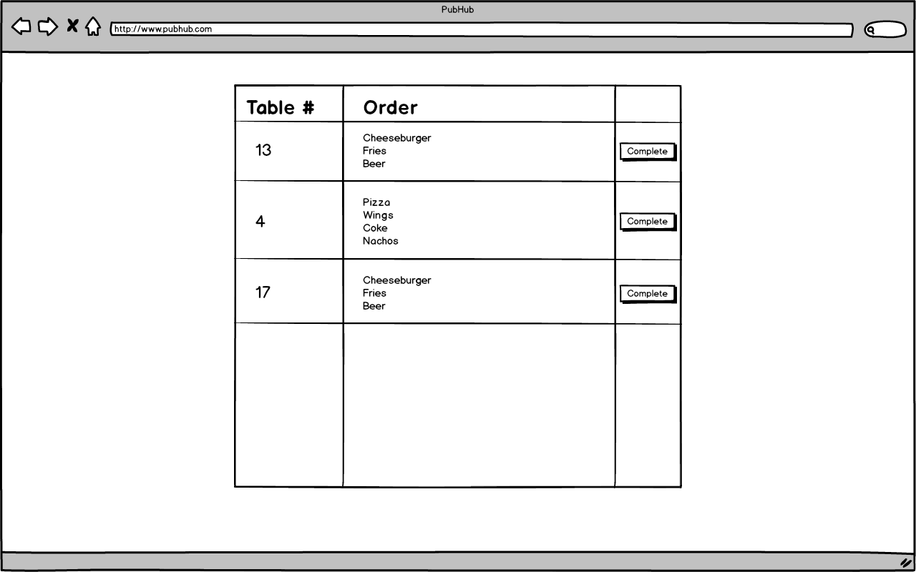
Orders

Slide 11
Breakdown
Person 1 | Person 2 | Person 3 | Person 4
Trivia play: App Trivia presentation: Web | Trivia creation: Web Database: Back end Login: App* Login: Web* | Chat: Back end Trivia: Back end User Management: Back end | QR codes: App QR codes: Web Chat: App Chat: Web

